Slide 1
Talking is Teaching: Talk, Read, Sing An Innovative Campaign to Boost Early Learning and Close the “Word Gap”
Welcome Baby
Training Presentation
Notes:
Welcome & Introduction
“Talking is Teaching: Talk Read Sing” is an innovative campaign to support early learning and development.
We aim to provide families with information & high-quality tools to help them talk, read and sing more with their very young children. We hope that together, we can close the “word gap” and help prepare our youngest children for success in school and beyond.
This presentation gives an overview of the research behind the word gap, and then outlines the key components of this campaign – our messages, our tools, & the trusted messengers that we are working with to deliver them directly to parents & caregivers.

Slide 2
Background
Every word a child hears impacts brain development and sets the foundation for future reading and literacy skills.
When a child is left alone in front of a TV, the part of her brain responsible for language development receives little stimulation.
That’s why First 5 CA’s new campaign encourages parents to talk, read, and sing to their babies. These activities exercise a baby’s brain, helping it grow bigger and stronger.
Children build most of their speech and language skills during the first three years of life.

Slide 3
The Research
Lower-income children hear 30 million fewer words than affluent children do.
This has lifelong implications for learning and success.
Number of Words Learned
1200
Total Words
600
Source: Hart & Risley (1995)
200
16
24
36
Notes:
As you may know, decades of research has shown that the more words and conversation parents and caregivers direct at their children through actions like talking, reading and singing, the more their children’s vocabulary and early learning skills improve.
And it’s not just about reading a book or showing flashcards—parents must engage their children in back-and-forth communication and in a nurturing, loving environment for proper early brain development.
But that same research shows that children in low-income families hear about 30 million fewer words by their 4th birthday than children in high-income families.
We know that the number of words heard directly relates to the number of words learned, which you can see on these graphs.
On average, a 3-year-old child from a family of affluent, educated parents knows 1,100 words, while a 3-year old child from a low-income family knows only 500.
New research has taught us that children as young as 18 months old already show evidence of falling behind in language recognition and vocabulary development.
This “word gap” can lead to an achievement gap in school and later in life.

Slide 4
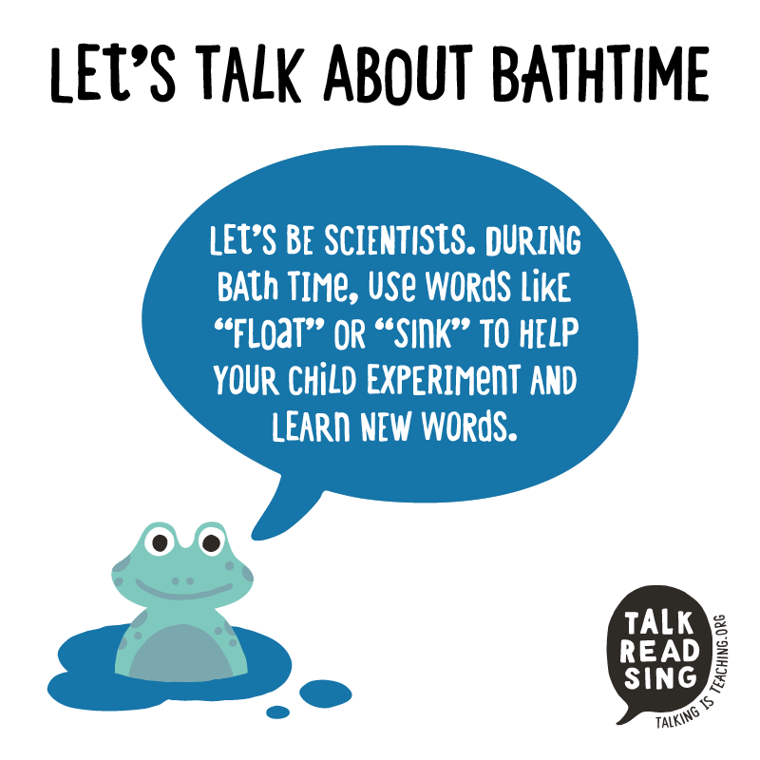
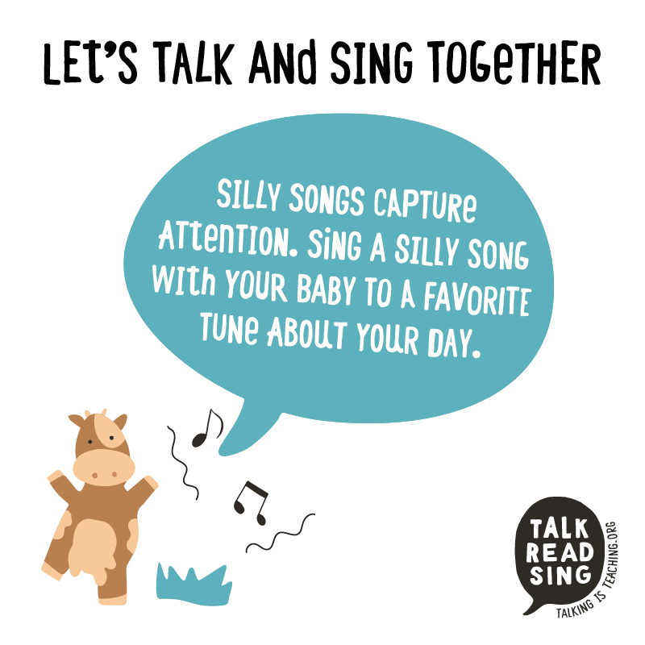
“Talking is Teaching: Talk, Read, Sing” is a public awareness and action campaign to get parents to talk, read, and sing with their young children.
The Campaign aims to help parents understand the critical role they play in their child’s development.
YOU will be a part of this campaign by teaching families how to engage in language-rich activities with their children.
These simple actions can improve a baby’s ability to learn new words and concepts.
Notes:
“Talking is Teaching: Talk, Read, Sing” is a public awareness and action campaign that aims to motivate parents and caregivers to talk, read, and sing more with their young children from birth.
The campaign partners with trusted messengers to share information with parents about the critical role they play in their child’s development, as well as concrete tools to help them engage in language-rich activities with their children.
Paid and social media efforts reinforce that simple actions – like describing objects seen during a walk, singing songs, or telling stories – can significantly improve a baby’s ability to learn new words and concepts.

Slide 5
Talking is Teaching: Talk, Read, Sing
The TRS campaign focuses on 3 things that motivate behavior change:
Trusted messengers
Environmental prompts & paid media
Tools to facilitate change
Notes:
We know we can close the word gap if we can convince parents and caregivers—especially those living in high-risk communities—that they have the power to make change happen, simply by talking, reading and singing WITH their children every day from birth.
In order for parents to believe these research-tested messages and engage in these behaviors, three things must happen:
They must hear from people they trust. For example in focus groups conducted, parents identified pediatricians, friends & family as highly trusted sources.
They must find reinforcements of those messages in their environment. We are placing our media on billboards, bus shelters, places where families spend time. To reinforce messages they get – and actively engage them in talking, reading and during everyday activities, like while they are waiting for the bus.
They must have the tools they need to facilitate these conversations. We are employing tools that offer concrete suggestions, examples that model activities, and reminders to parents about how they can engage in this behavior.
We’re seeking to make these three things happen through our “Talking is Teaching” campaign, which has developed a way to share these messages using trusted messengers.
A central piece of this campaign’s approach is to help parents integrate these actions into their daily routines. We know that parents are often overwhelmed and busy, and so we want to show them that they can take small actions during their regular routine – like singing a silly song while changing their baby’s diaper – and make a big impact on their child.

Slide 6
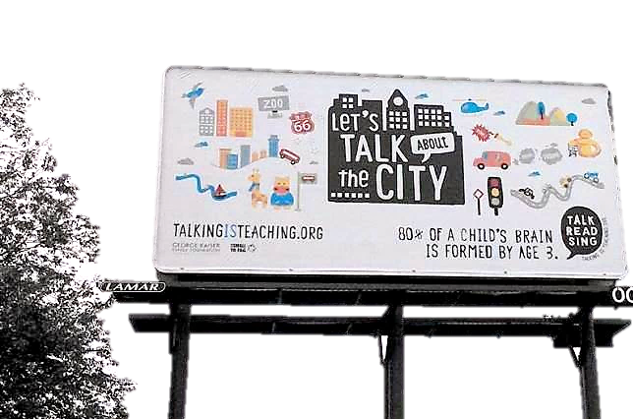
L.A. Campaign: Media Messages
TRS campaign messages in L.A. use these paid media:
Billboards
Radio
Newspapers
TV Spots
Social Media
Notes:
The Talking is Teaching campaign employs a range of communications tactics for raising public awareness. Paid media reinforces messages the campaign is already delivering to parents and caregivers directly on the ground. Earned media has engaged the nation with the “big picture” narrative about the word gap, and increasingly is used in local markets to highlight personal family stories and the ways parents and caregivers are receiving important information and tools to help them improve their children’s early learning. Talking is Teaching also takes advantage of a wide range of social media channels for communicating with parents, funders and all of its local and national partners. Learn more about each communications strategy, download customizable templates, and view examples from our local campaigns.
To that end, our effort involves a community-wide, multi-media campaign.
Our messages highlight for parents and caregivers how simple actions done every day from birth—like describing objects seen during a bus ride, asking questions, singing songs, reading aloud, or telling stories—can significantly improve a baby’s ability to build vocabulary and develop their brains.
Campaign messages will appear on billboards, bus ads and in paid media spots.
We hope that these messages will not only reinforce the campaign’s themes, but also will prompt parents to take action right then & there – while they are waiting at a bus stop, shopping in a grocery store, driving in the car or going for a walk through the neighborhood.

Slide 7
L.A. Campaign: Broadcast Highlights
“Successful Futures” 30-second TV spot ran statewide.
30-second TV spot featured Univision’s Omar & Argelia.
45+ custom TV vignettes featuring local network talent aired across 28 different media outlets.
59 custom radio spots featuring Mario Lopez & local talent together.
20+ custom radio 30-second live reads featured local talent.
40+ custom radio 10- and 15-second live read traffic and sponsorships
Station-recorded Spanish language spots, including hard-to-reach TV and radio, including Mixteco and Hmong.
Over 400 million impressions were
delivered across a
4-month period.
Notes:
To that end, our effort involves a community-wide, multi-media campaign.
Our messages highlight for parents and caregivers how simple actions done every day from birth—like describing objects seen during a bus ride, asking questions, singing songs, reading aloud, or telling stories—can significantly improve a baby’s ability to build vocabulary and develop their brains.
Campaign messages will appear on billboards, bus ads and in paid media spots.
We hope that these messages will not only reinforce the campaign’s themes, but also will prompt parents to take action right then & there – while they are waiting at a bus stop, shopping in a grocery store, driving in the car or going for a walk through the neighborhood.

Slide 8
L.A. Campaign: Community Touch Points
Touch Points for the
TRS LA Campaign via
F5LA’s Welcome Baby Program
Home Visiting Programs
Child Care Centers/Schools
Welcome Baby Partnering Hospitals
Family Strengthening Programs
Faith Leaders & Churches
Pediatric Clinics, Private Practices
Local Resources Identified by Welcome Baby
Former Clients/Welcome Baby Moms!
Notes:
We are actively working in partnership with… [Talk about your partners, for example: pediatricians, business leaders, community advocates, faith-based leaders, etc.]
Local organizations, churches, libraries and health care providers will help raise awareness by sharing materials and information with parents and caregivers about early brain growth.
These campaign messengers will distribute “Talking is Teaching: Talk, Read, Sing” directly to families.

Slide 9
Talking is Teaching Materials/Toolkit: A Conversation Starter
Toolkits include 3 high-quality items that encourage parents to engage every day with their young children
All materials come in English and Spanish
Pre-packaged toolkits have been delivered to your site
Toolkits given to ALL families (BS/NBS)
at the 2-month visit
Notes:
Here you can see the concrete tools that we are distributing to families through trusted messengers.
These toolkits include a number of high-quality materials that we are handing out to parents and caregivers to encourage them to engage their children as much as they can every day.
All of the materials are available in both English and Spanish.
[THESE MATERIALS MAY BE ADAPTED TO MEET INDIVIDUAL COMMUNITY’S NEEDS AND RESOURCES, SO PLEASE ADAPT THESE SLIDES AS NEEDED]

Slide 10
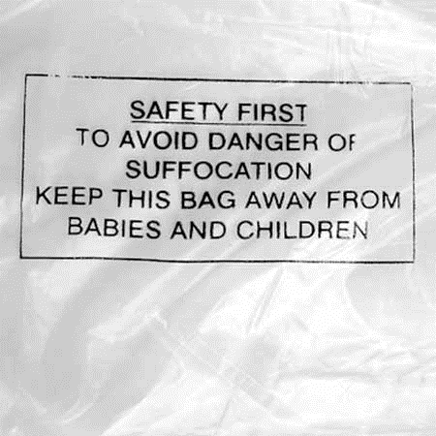
Talking is Teaching Materials/Toolkit: A Conversation Starter
Go through each item and discuss how to incorporate talking, reading, and singing into daily routines.
The kits come in plastic bags. After presenting TRS items, review the hazards associated with plastic bags.
Take the empty plastic bag when you leave the home.
Notes:
Here you can see the concrete tools that we are distributing to families through trusted messengers.
These toolkits include a number of high-quality materials that we are handing out to parents and caregivers to encourage them to engage their children as much as they can every day.
All of the materials are available in both English and Spanish.
[THESE MATERIALS MAY BE ADAPTED TO MEET INDIVIDUAL COMMUNITY’S NEEDS AND RESOURCES, SO PLEASE ADAPT THESE SLIDES AS NEEDED]

Slide 11
Talk, Read, Sing Blanket
The TRS blanket doubles as an educational tool: it prompts parents to talk, read, and sing to their children.
Designed with graphics and prompts optimized for learning based on the child's age and environment.
Provides parents with an easy way to transform everyday life into an opportunity to talk, read, and sing.
Notes:
Inside each tote bag is an item of baby clothing with age-appropriate prompts to remind the parents to engage with their babies.
This onesie says “Where are my toes?”, “Peek-a-boo,” and “1, 2, 3, 4, 5 fingers!” . A t-shirt for toddlers may ask about shapes or letters.
These designs were created in consultation with early childhood development experts, and tested in focus groups with low income families.

Slide 12
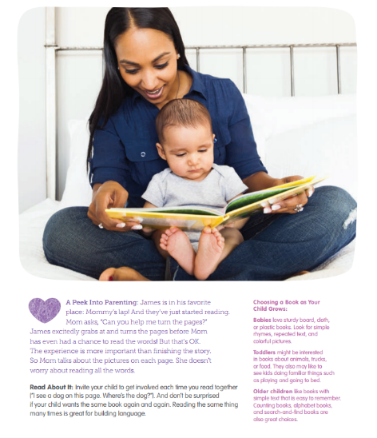
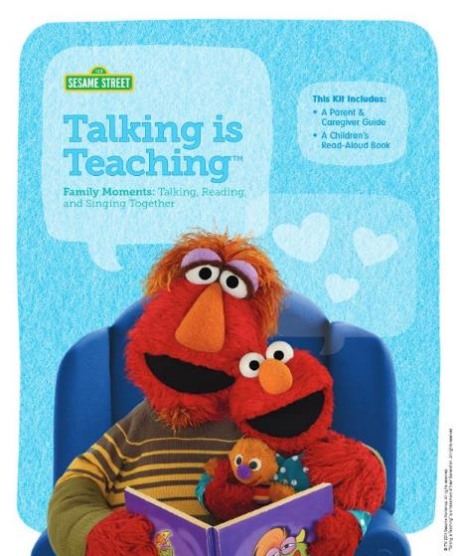
Sesame Street “Talking is Teaching” Parent/Caregiver Guide
Includes tools, ideas, and activities that help parents learn to talk, read, and sing with their young children during their daily routines.
Walk through the guide with mom and show her the tips and activities she can use with her baby.
Use everyday moments, like grocery shopping or bath time, as a time to talk with your child about the world around him.
Make sharing a book a time to bond by snuggling with your baby in your lap.
Notes:
The “Talking is Teaching Family Resource Guide” was developed in partnership with Sesame Street.
One of the things we heard about from parents in focus groups, is that they knew it was important to engage with their children, but they wanted more specific ideas.
This guide gives a number of examples parents and caregivers can use with their children, along with photos that model behavior.

Slide 13
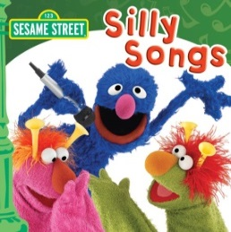
Music CD
The CD has both English and Spanish songs.
Educate parents about how music is a great bonding tool.
Suggest families can play the CD during everyday activities.
Encourage moms to sing, dance, and talk about the songs with their babies.
Notes:
The totes include a CD to encourage singing, as well as age-appropriate books.
We encourage parents to begin sharing books with their children beginning at birth, even if they just want to look at pictures on one page or put the book in their mouths.
And we tell them not to worry about how they sound when they sing – their baby loves to hear their voice!

Slide 14
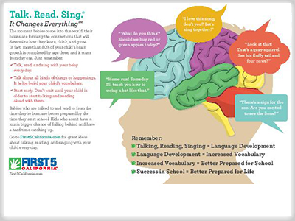
New Parent Kit Insert
The F5CA New Parent Kits include this “Talk, Read, Sing” insert
When you review the New Parent Kit with families, let families know about the campaign and its purpose.
Notes:
Finally, there is a postcard encouraging parents to sign up for the service, Text4baby.
This is a free text message service for new parents that provides 3 texts a week with reminders about the health of their baby. Examples include reminders to get baby vaccinated or links to resources to help them sign up for health insurance.
Through a new partnership with Text4baby, Sesame Street, and Too Small to Fail, now all parents who get this service are receiving regular texts about the importance of early brain development in addition to health & safety. They also get a link to a cute video from Sesame Street that models behavior about engaging with a baby.
This service is FREE for most cellphone users thanks to generous support from the Wireless Foundation– more information about the service can be found at www.text4baby.com, under “FAQ”.
When our partners hand out the tote bags, they also verbally encourage parents to sign up for this service right there, and emphasize that they will not be charged for the texts.

Slide 15
Evaluation Goals
Are parents talking, reading, and singing more with their children starting at birth?
Which messages and tools were most effective?
What can we learn from the process of implementation?
Notes:
“Talking is Teaching” is intended to be a data-driven model. In other words, we need to know if what we’re doing is working.
The question is whether – and how – this approach can change parent behavior and improve the quality of interactions between parents and their children beginning at birth.

Slide 16
Powered by Great National & Local Partners
Notes:
This content was developed in partnership with some amazing national organizations.
And our local campaign is thrilled to have the support of [list your local partners].

Slide 17
Talk Read Sing: Review
Overview
Kits are to be provided during Welcome Baby 2-month visit
Includes ALL moms who receive a 2-month visit – BS and NBS mom
Kits available in English and Spanish
Clients that miss the 2-month visit DO NOT receive the TRS materials
Clients that receive the 2-month visits late, documented in the SFDB as “other visit” do receive the TRS materials
Talk Read Sing Launch
PC’s can start taking the kits to moms during their 2-month visits once they have:
Received training and overview provided by a Program Manager, Clinical Supervisor, or PC Supervisor who has attended the training webinar.
OR
Received training by attending the webinar.

Slide 18
Talk Read Sing: Review
TO Do’s
Print out labels/cards to accompany prepackaged kits with First5LA.org/parenting website.
PC’s to check out kits on inventory sheet.
PC’s to incorporate a lesson about the safety hazards associated with plastic bags; point out the warning label on the bag that contains the kit .
Make sure you take the plastic bag when you leave the home
Review each item in the kit and help parents think of ways they can use the tools to talk, read, and sing with their baby.
For a copy of this presentation, resources, tip sheets, talking points, labels and inventory sheets discussed during this presentation, visit the Talk Read Sing section on the LABBN website:
http://www.labestbabies.org/welcome-baby/home-visiting-resources

Slide 19
Thank You!
For questions, feedback, comments:
Amanda Helvie
Sr. Communication Specialist
LA Best Babies Network
P: 213-250-7273, x102
E: ahelvie@labestbabies.org
For information and tips for parents:
First5LA.org/Parenting
TooSmall.org or TalkingIsTeaching.org
@2SmalltoFail

